Slide 1
Compiler Principles and Design
Weixing Ji

Slide 2
Course Lecturer
Who am I?
Weixing Ji, Associate Professor, bitjwx@126.com
Make sure the title starts with “[compiler-English]”
Research topics: Parallel Programming, Program Analysis and Big Data
Office: Room 932, Central Teaching Building
Office Hour: make an appointment via email
Lectures
Tuesday and Friday
How to study
Make your own notes, Read the book, Practice

Slide 3
Module Aims
Any program written in a programming language must be translated before it can be executed
Translation is typically accomplished by a software system called compiler.
Aims to introduce students to the principles and techniques used to perform this translation and the issues that arise in the construction of a compiler

Slide 4

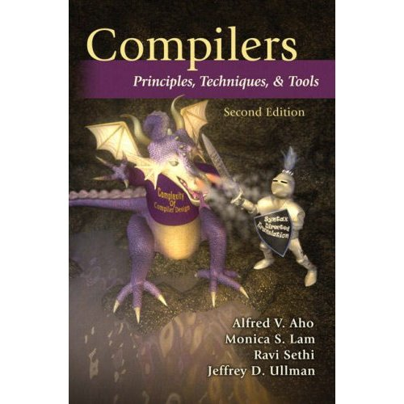
Textbook
Alfred V. Aho, Monica S. Lam, Ravi Sethi, Jeffrey D. Ullman. “Compilers: Principles, Techniques and Tools”, 2nd edition. (Aho2)
the “Dragon Book”, has been a classic for over 20 years
Michael L. Scott. “Programming Language Pragmatics” 3rd edition

Slide 5
Learning Outcomes
A student successfully completing this module should be able to
understand the role of each of the basic components of a standard compiler
show awareness of the problems of and methods and techniques applied to each phase of the compilation process
apply standard techniques to solve basic problems that arise in compiler construction
understand how the compiler can take advantage of particular processor characteristics to generate good code

Slide 6
Requirements & Grading
Roughly
60% exam
10% individual written homework
25% project
5% other
Homework submission
Individual written homework
Project → bitjwx@126.com
id_name_project_name.zip(source, doc, tests and outputs)
never misrepresent work done by someone else as your own
project should ultimately be created by you

Slide 7
Syllabus
Introduction
Programming Language and specification
C & Java
Computer Architecture basic
MIPS
Lexical Analysis (scanning)
Syntax Analysis (parsing)
Semantic Analysis
Intermediate Representations
Storage Management
Code Optimisation
Code Generation
Exercise In Between

Slide 8
Definitions
What is a compiler?
A program that accepts as input a program text in a certain language and produces as output a program text in another language, while preserving the meaning of that text (Grune et al, 2000).
A program that reads a program written in one language (source language) and translates it into an equivalent program in another language (target language) (Aho et al)
What is an interpreter?
A program that reads a source program and produces the results of executing this source.
We deal with compilers! Many of these issues arise with interpreters!

Slide 9
Examples
Source program
compiler
C is typically compiled
Lisp is typically interpreted
Java is compiled to bytecodes, which are then interpreted
Also:
C++ to Sparc/Pentium/... Assembly
C++ to C
High Performance Fortran (HPF) to Fortran (parallelising compiler)
C to C (or any language to itself)
Target program

Slide 10
Qualities of a Good Compiler
What qualities would you want in a compiler?
generates correct code (first and foremost!)
generates fast code
conforms to the specifications of the input language
copes with essentially arbitrary input size, variables, etc.
compilation time (linearly)proportional to size of source
good diagnostics
consistent optimisations
works well with the debugger

Slide 11
Principles of Compilation
The compiler must
preserve the meaning of the program being compiled
“improve” the source code in some way
Other issues (depending on the setting)
Speed (of compiled code)
Space (size of compiled code)
Feedback (information provided to the user)
Debugging
Compilation time efficiency (fast or slow compiler?)

Slide 12
Why study Compilation Technology?
Success stories (one of the earliest branches in CS)
Applying theory to practice (scanning, parsing, static analysis)
Many practical applications have embedded languages (eg, tags)
Practical algorithmic & engineering issues:
Approximating really hard (and interesting!) problems
Emphasis on efficiency and scalability
Small issues can be important!
Ideas from different parts of computer science are involved:
AI: Heuristic search techniques; greedy algorithms - Algorithms: graph algorithms - Theory: pattern matching - Also: Systems, Architecture
Compiler construction can be challenging and fun
new architectures always create new challenges; success requires mastery of complex interactions; results are useful; opportunity to achieve performance.

Slide 13
Uses of Compiler Technology
Most common use: translate a high-level program to object code
Program Translation: binary translation, hardware synthesis, …
Optimizations for computer architectures:
Improve program performance, take into account hardware parallelism, etc…
Automatic parallelisation or vectorization
Performance instrumentation: e.g., -pg option of cc or gcc
Interpreters: e.g., Perl, sh, …
Software productivity tools
Debugging aids: e.g, purify
Security: Java VM uses compiler analysis to prove “safety” of Java code.
Text formatters, just-in-time compilation for Java, power management, global distributed computing, …
Key: Ability to extract properties of a source program (analysis) and transform it to construct a target program (synthesis)

Slide 14
Summary
A compiler is a program that converts some input text in a source language to output in a target language
Compiler construction poses some of the most challenging problems in computer science

Slide 15
Homework
Language cognition
Languages: C/C++, Java, Python, MIPS Assembly Language, Haskell(optional)
Algorithm: Bubble sort/ Quick Sort
Tasks: implementing the algorithm using different language
Lab Report
Language features
Performance
Usability
Program size
…

